Slide 1
There is / There are How many … ?
Basic 04 – Unit 10a

Slide 2
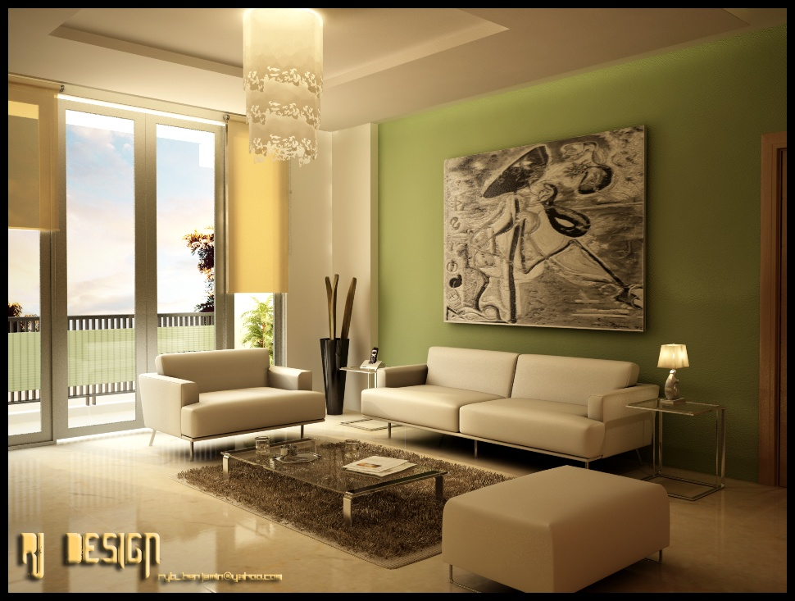

Slide 3
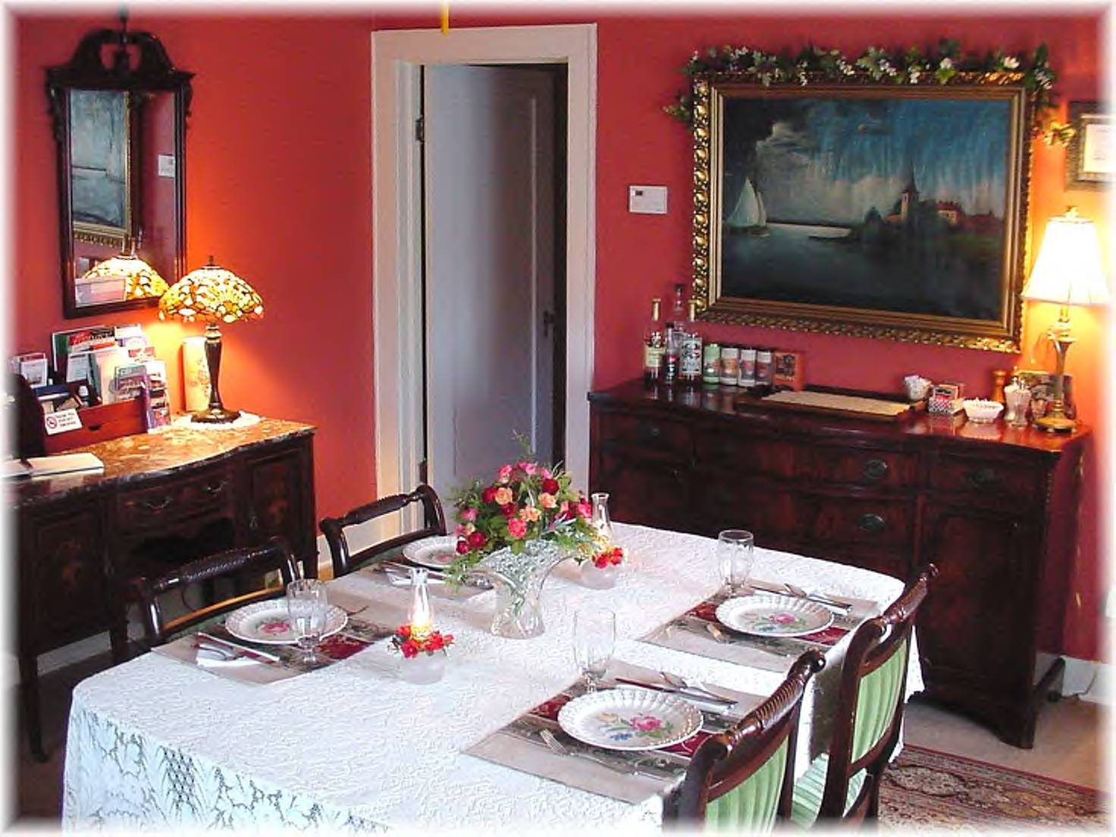

Slide 4
Yes/No Questions
There
is
there
a stove
?
Yes, there is.
No, there isn’t.
There
are
there
two beds
?
Yes, there are.
No, there aren’t.

Slide 5
Questions with there is/are
Is there furniture in your living room?
Is there a sofa in your bedroom?
Are there appliances in your kitchen?
Are there chairs in your kitchen?
Yes, there is.
No, there isn’t.
Yes, there are.
No, there aren’t (any).

Slide 6
Questions with there is/are
How many tables are there in the dining room?
There is one (table).
How many chairs are there in the kitchen?
There are five chairs.
How many beds are there in the living room?
There aren’t any (beds).

Slide 7
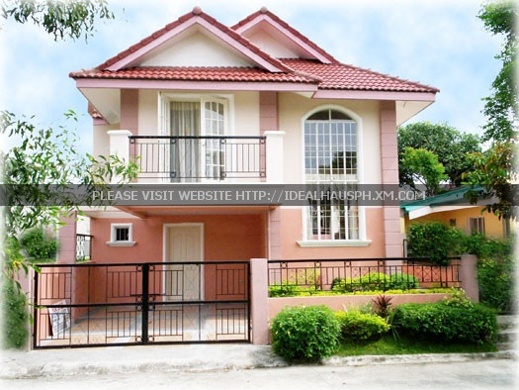

Slide 8
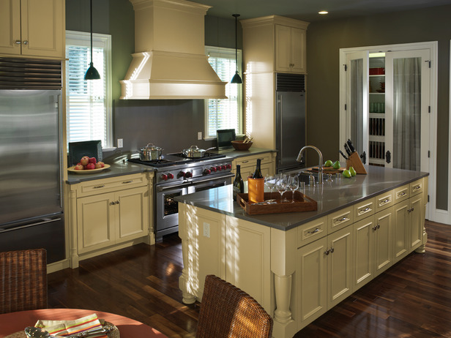

Slide 9
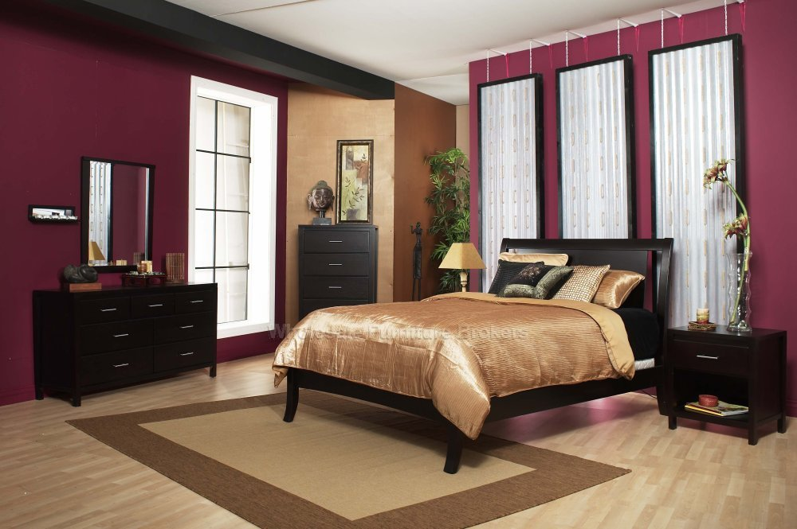

Slide 11
